Slide 1


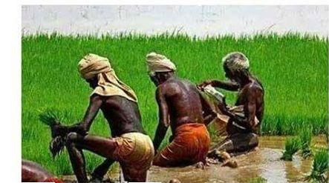

Slide 2
Dr. SATHIYARAJ THANGASAMY
Assistant Professor | Editor-in-Chief | Distributor at Mi Lifestyle Marketing | Researcher in Tamil & Computational Linguistics | LLM | RAG | AI | ML
E-Mail: sathiyarajkkt@gamail.com
Conduct: 9600370671Dr. SATHIYARAJ THANGASAMY
Assistant Professor | Editor-in-Chief | Distributor at Mi Lifestyle Marketing | Researcher in Tamil & Computational Linguistics | LLM | RAG | AI | ML
E-Mail: sathiyarajkkt@gamail.com
Conduct: 9600370671
Dr. SATHIYARAJ THANGASAMY
Distributor at Mi Lifestyle Marketing | Assistant Professor | Editor-in-Chief | Researcher in Tamil & Computational Linguistics | LLM | RAG | AI | ML
E-Mail: sathiyarajkkt@gamail.com, Conduct: 9600370671

Slide 3
HEALTH CARE
PERSONAL CARE
FOOD AND BEVERAGE
HOME CARE
AGRO CARE

Slide 4



Slide 5
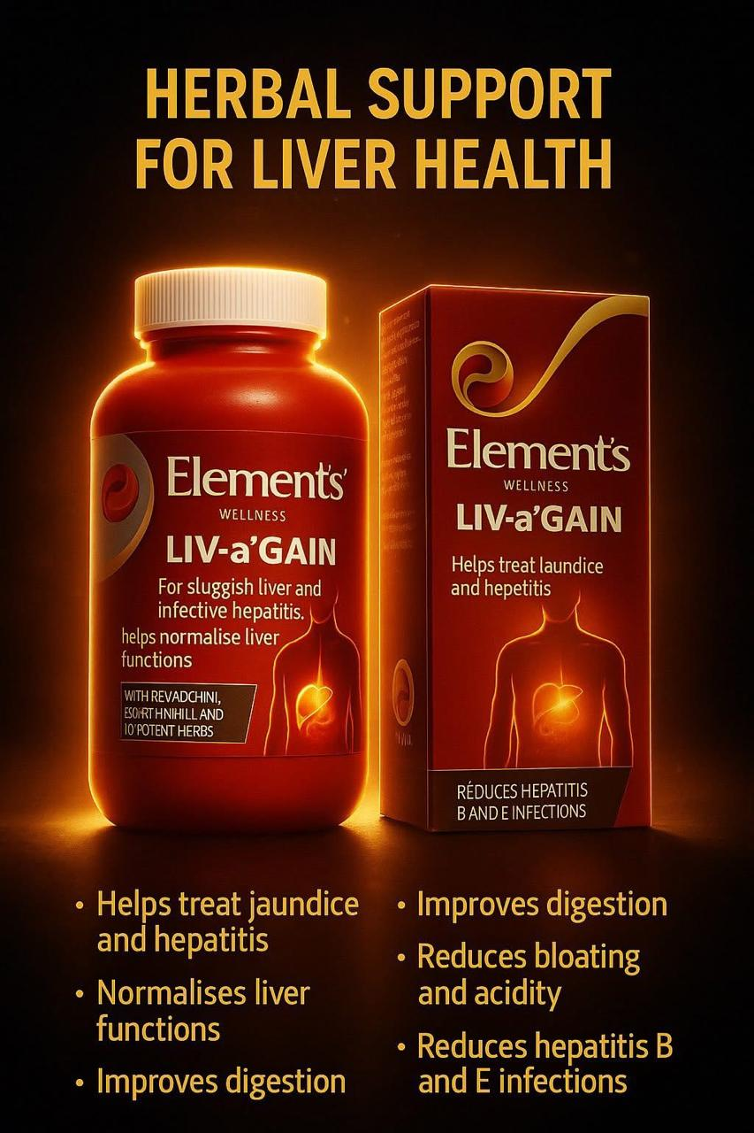


Slide 6
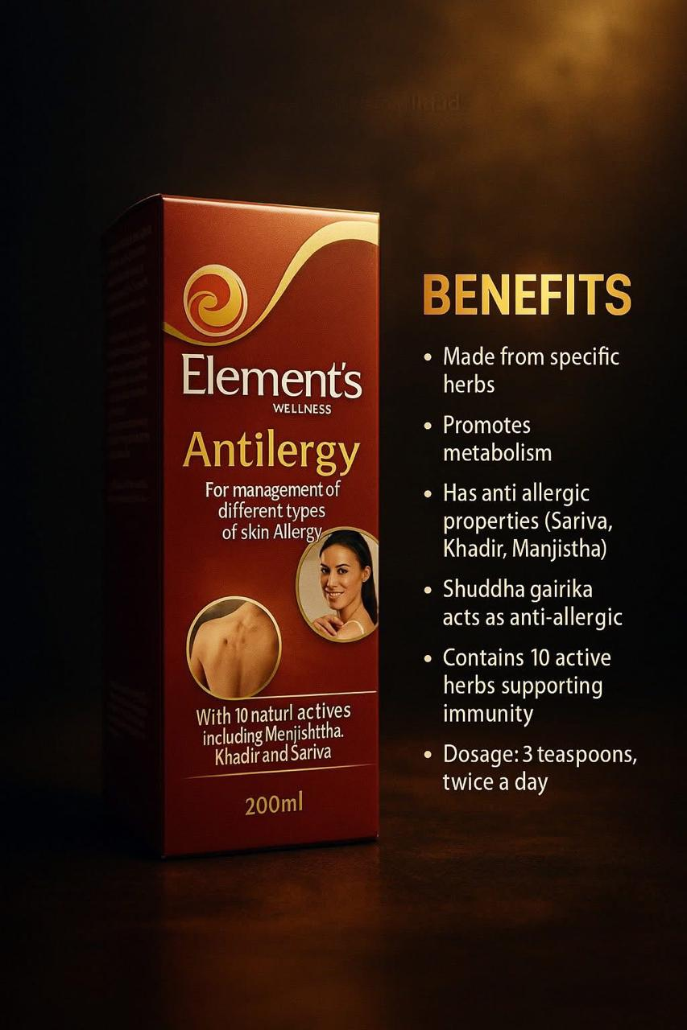
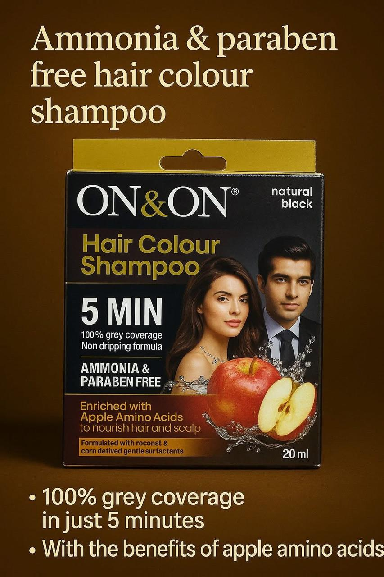

Slide 7



Slide 8

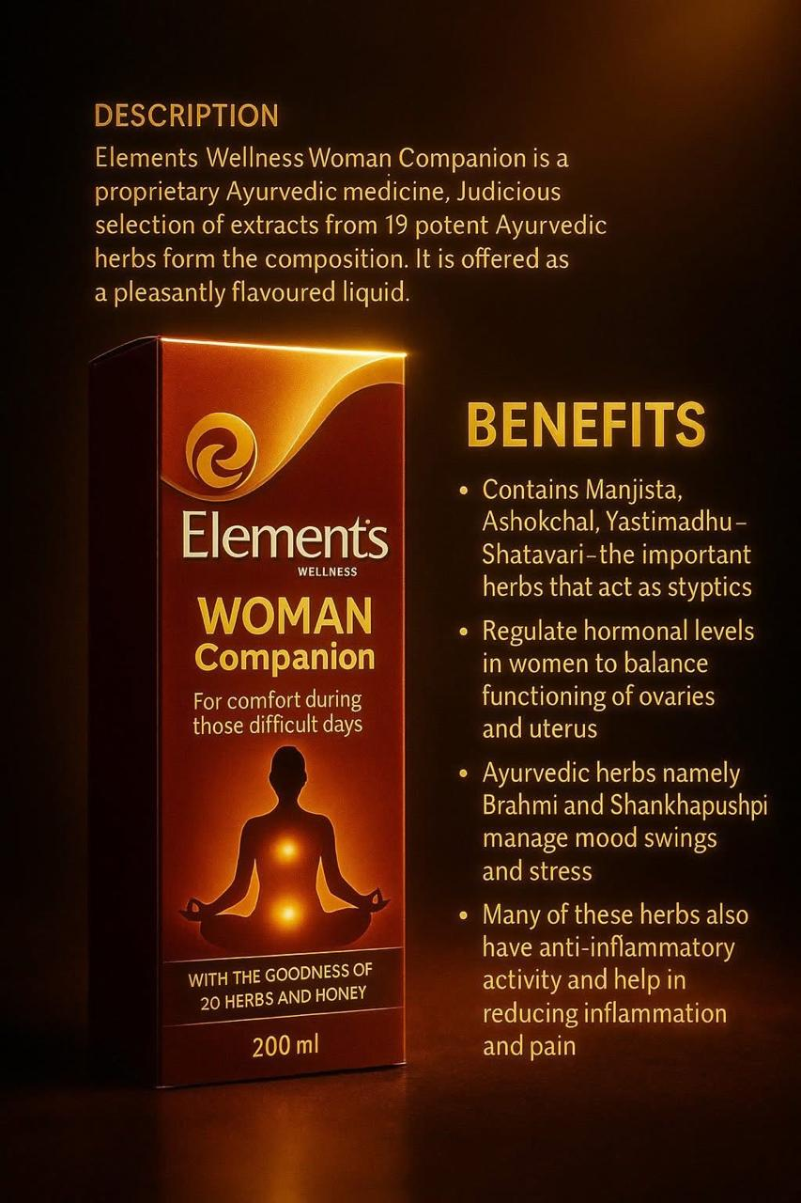

Slide 9

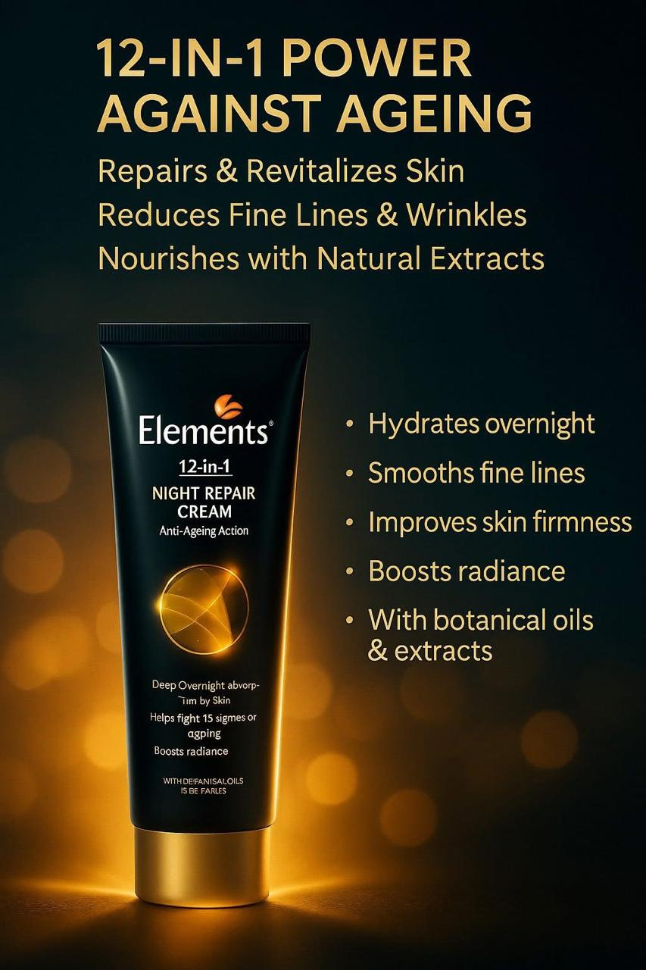


Slide 10
HEALTH CARE
PERSONAL CARE
FOOD AND BEVERAGE
HOME CARE
AGRO CARE

Slide 11
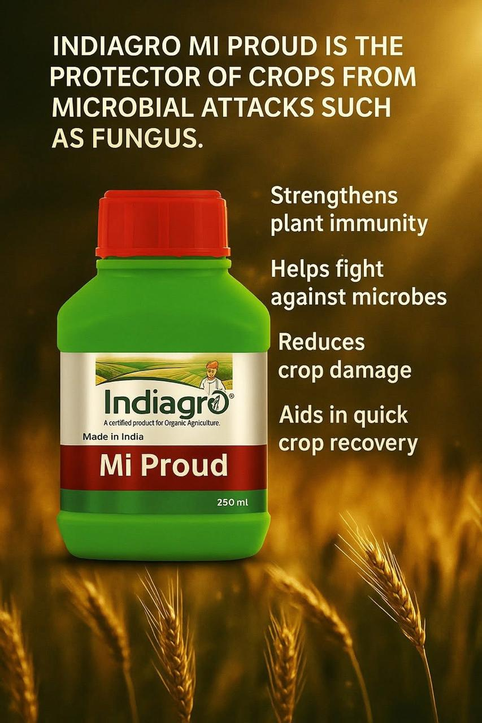
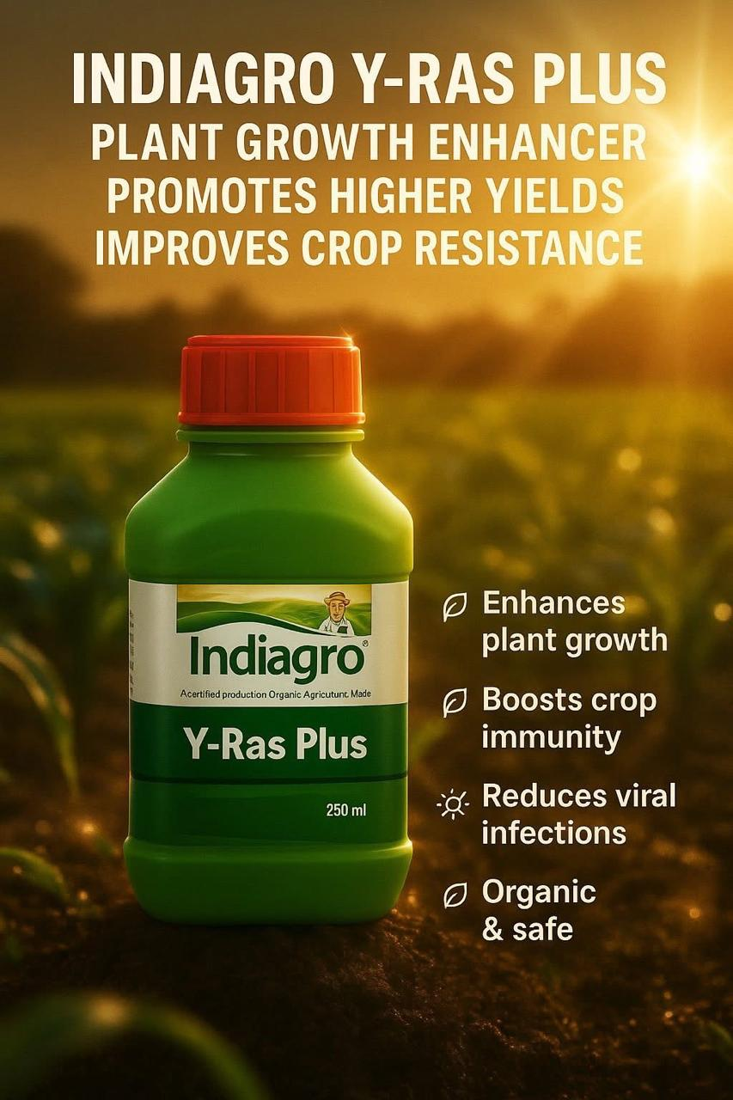

Slide 12
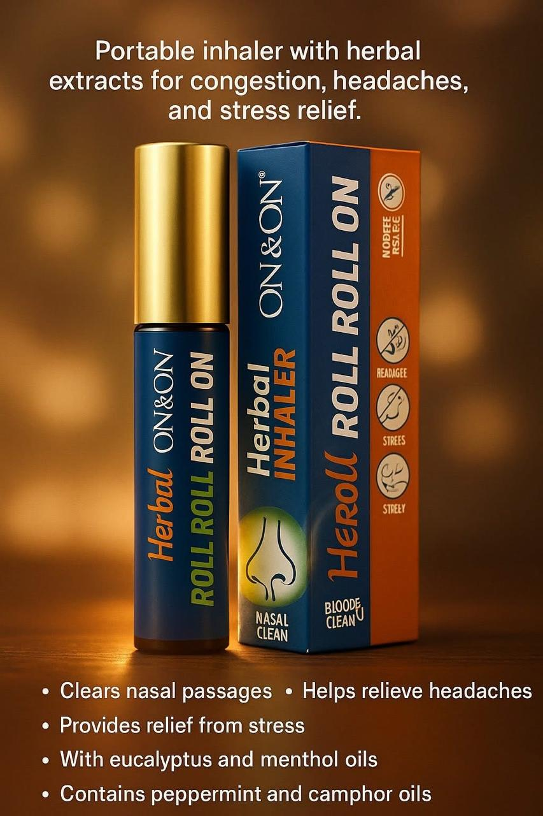
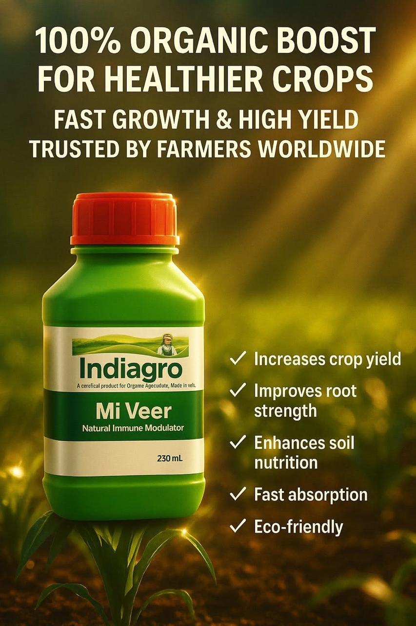

Slide 13

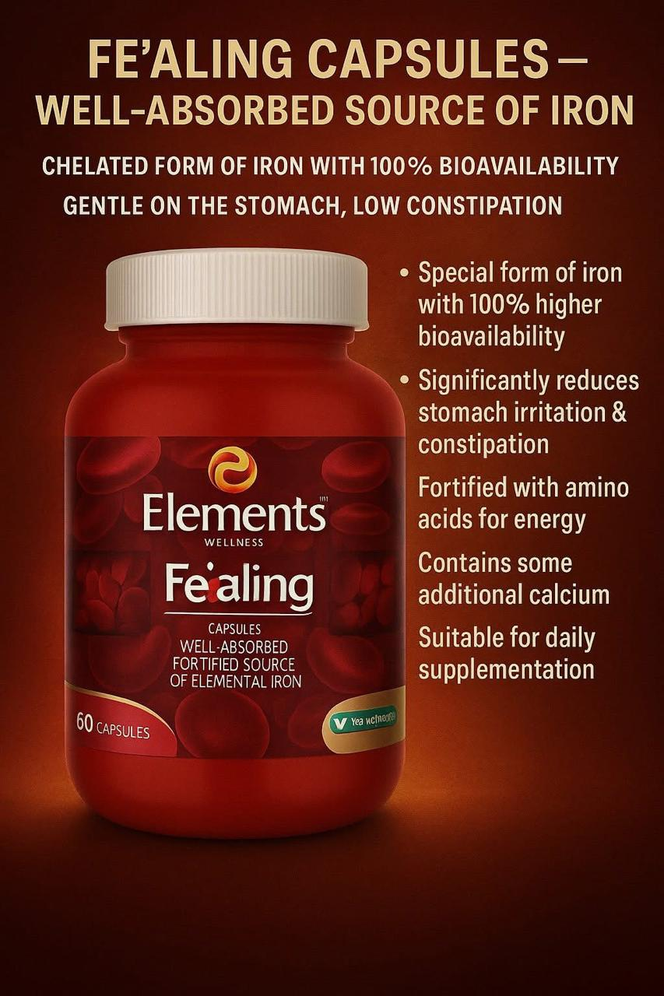

Slide 14



Slide 15
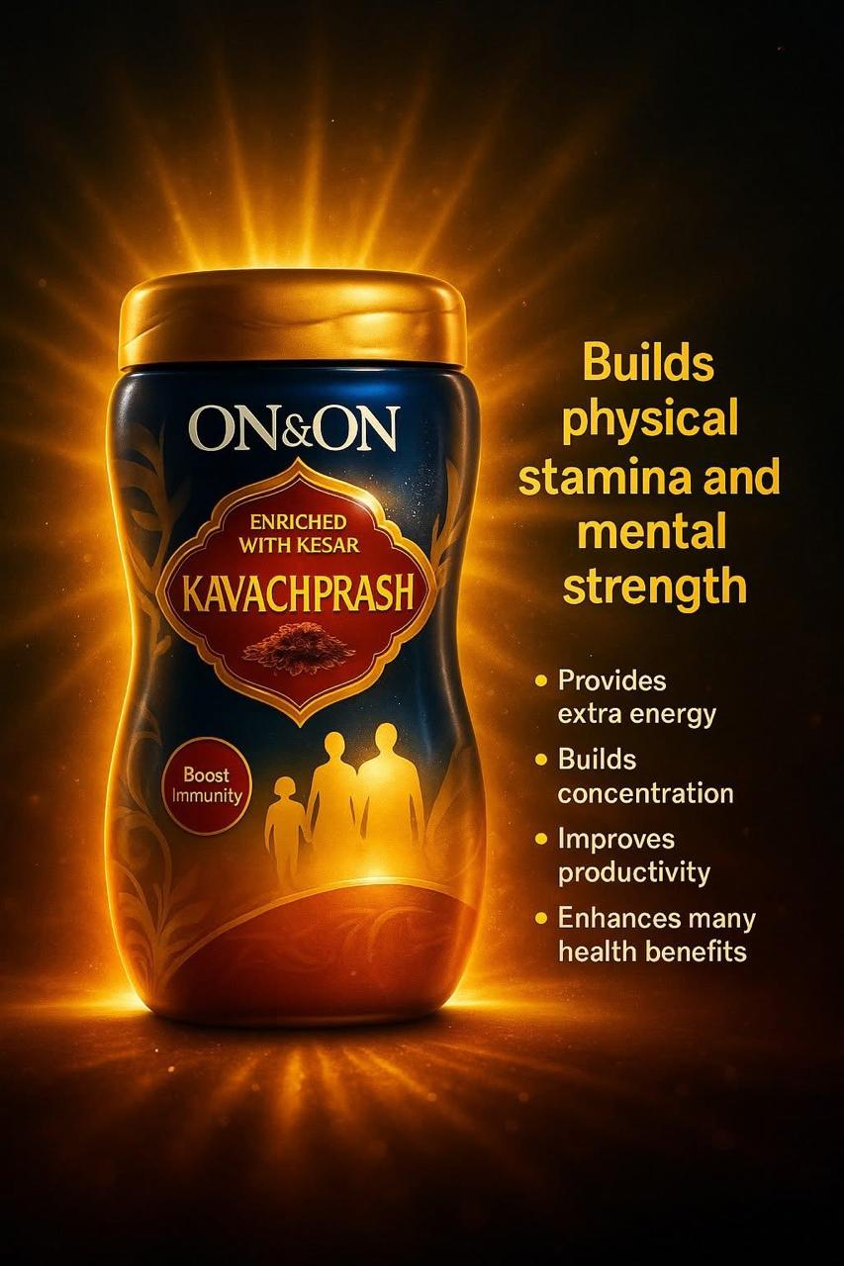
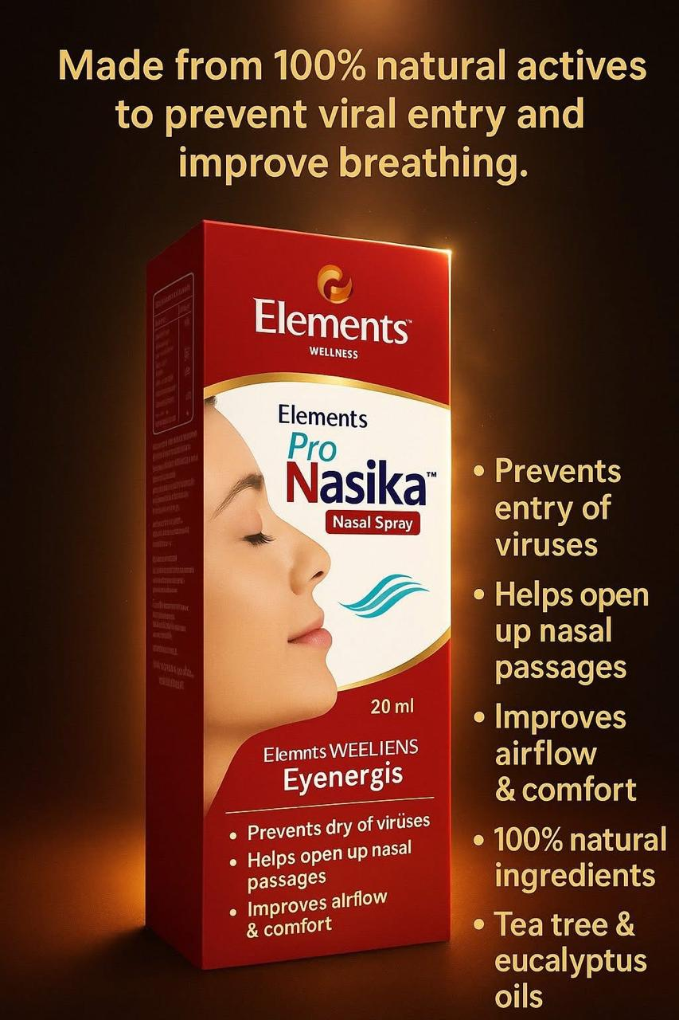

Slide 16



Slide 17

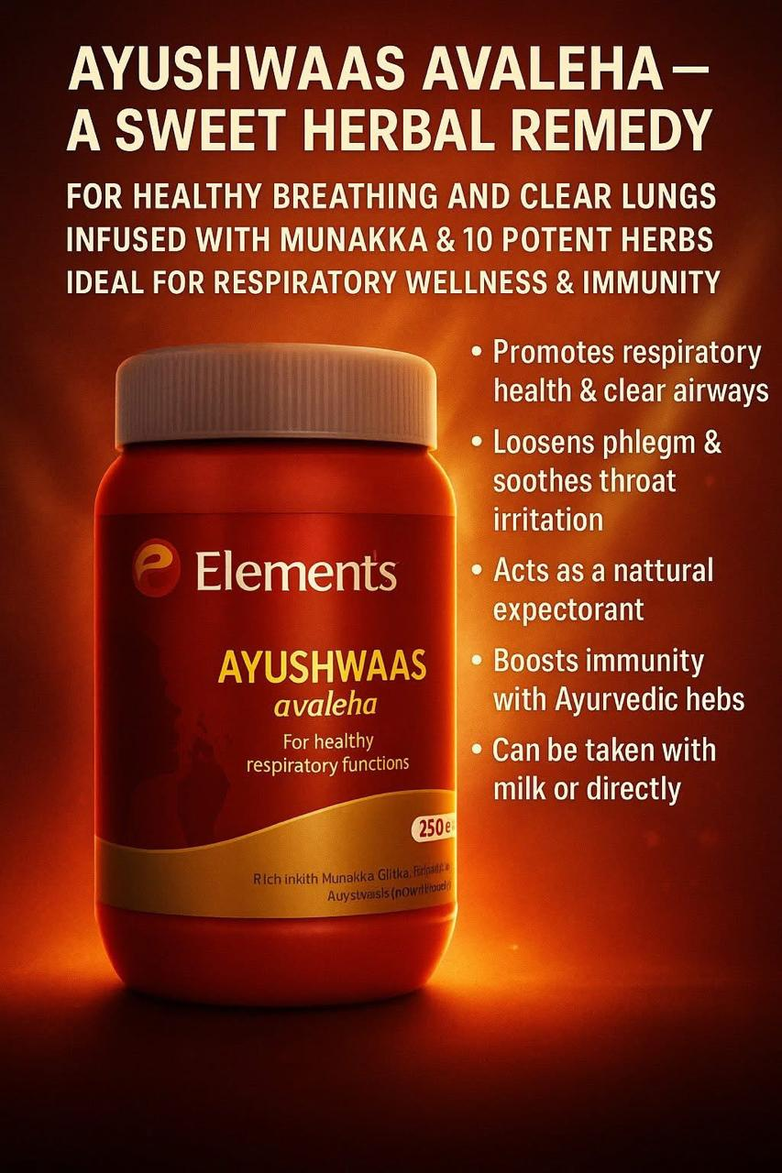

Slide 18



Slide 19
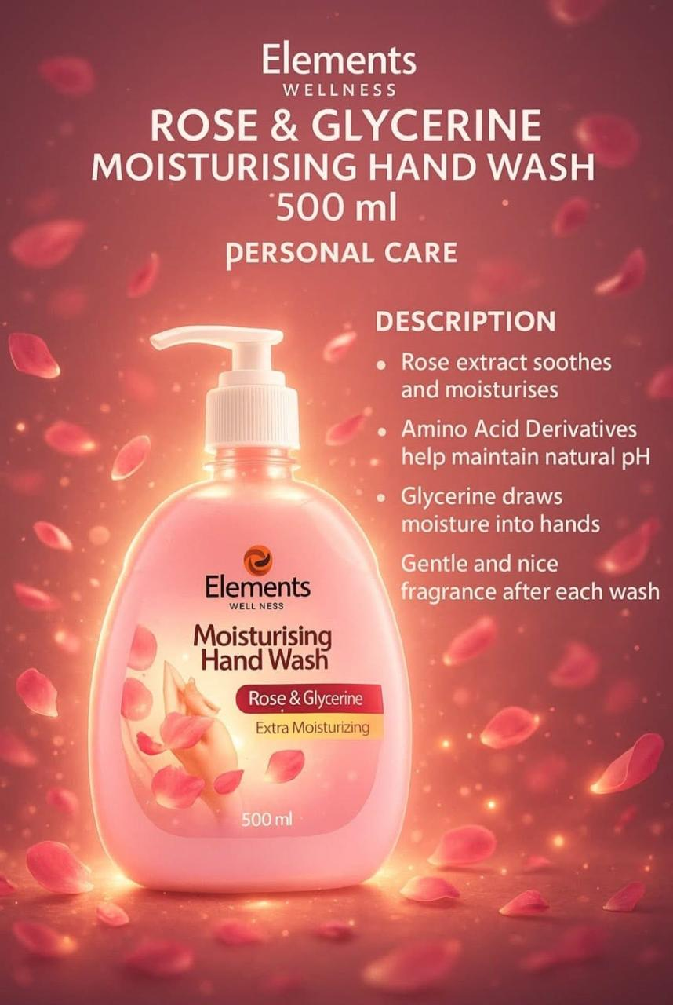


Slide 20
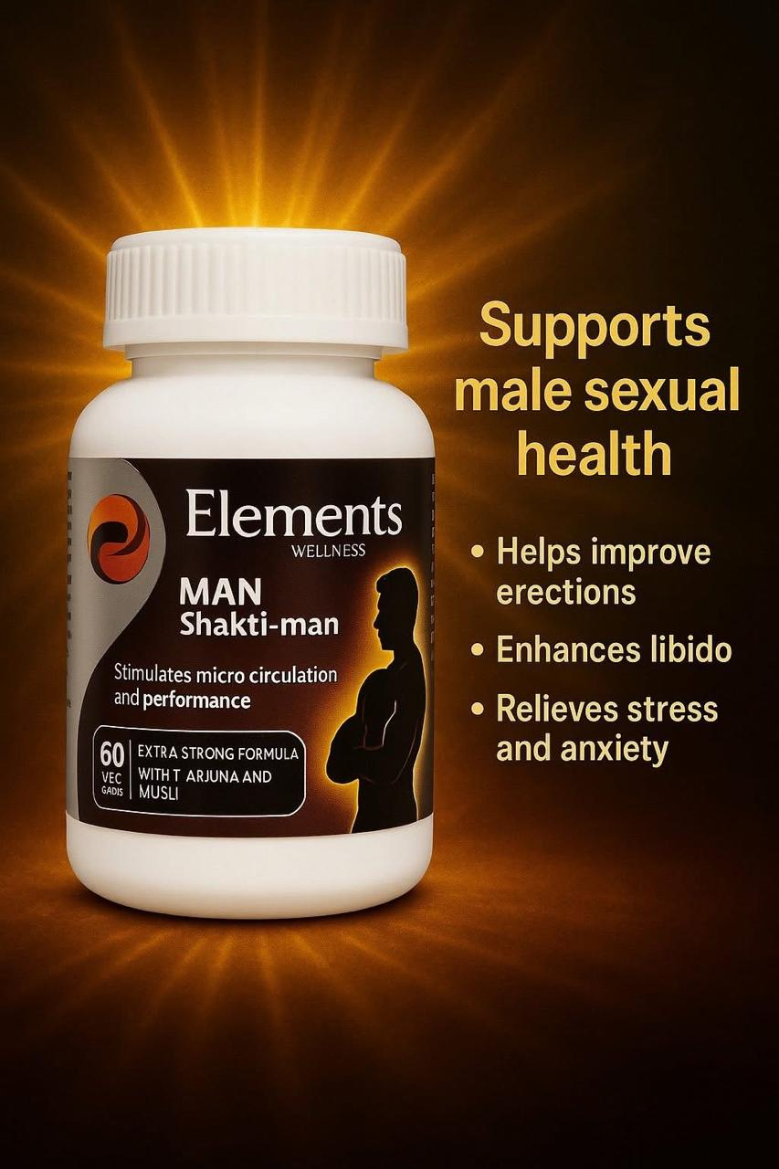
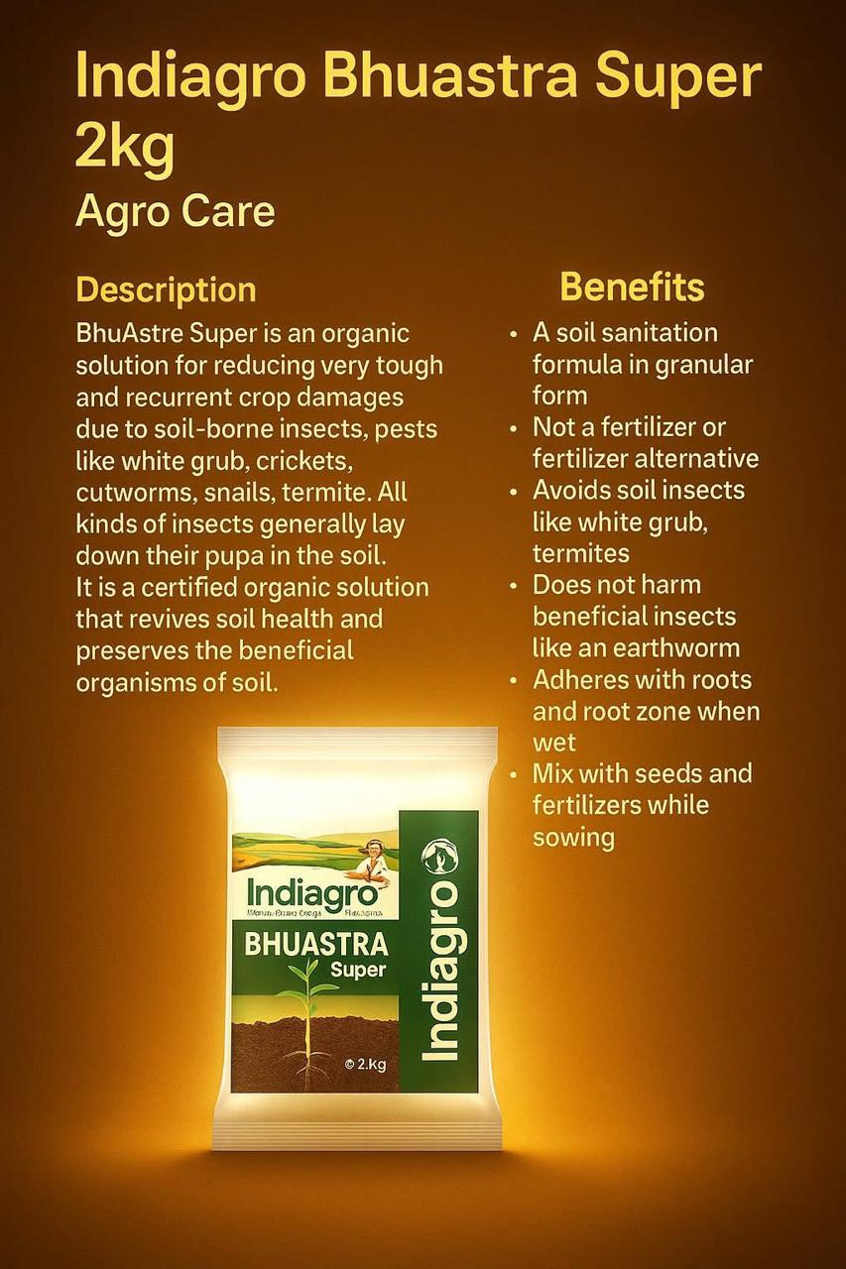

Slide 21

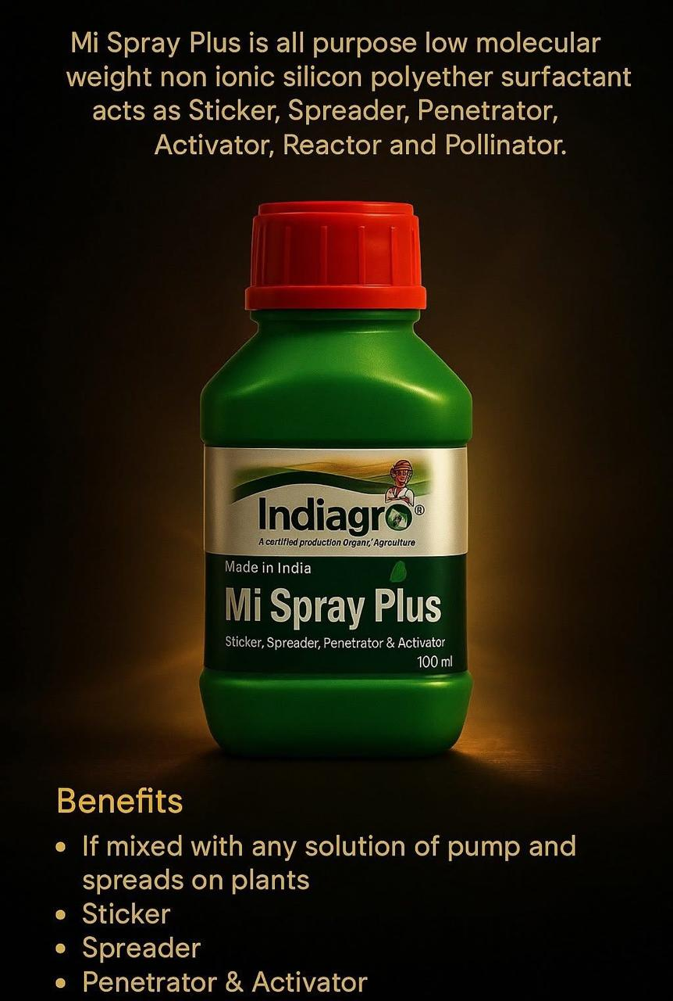

Slide 22

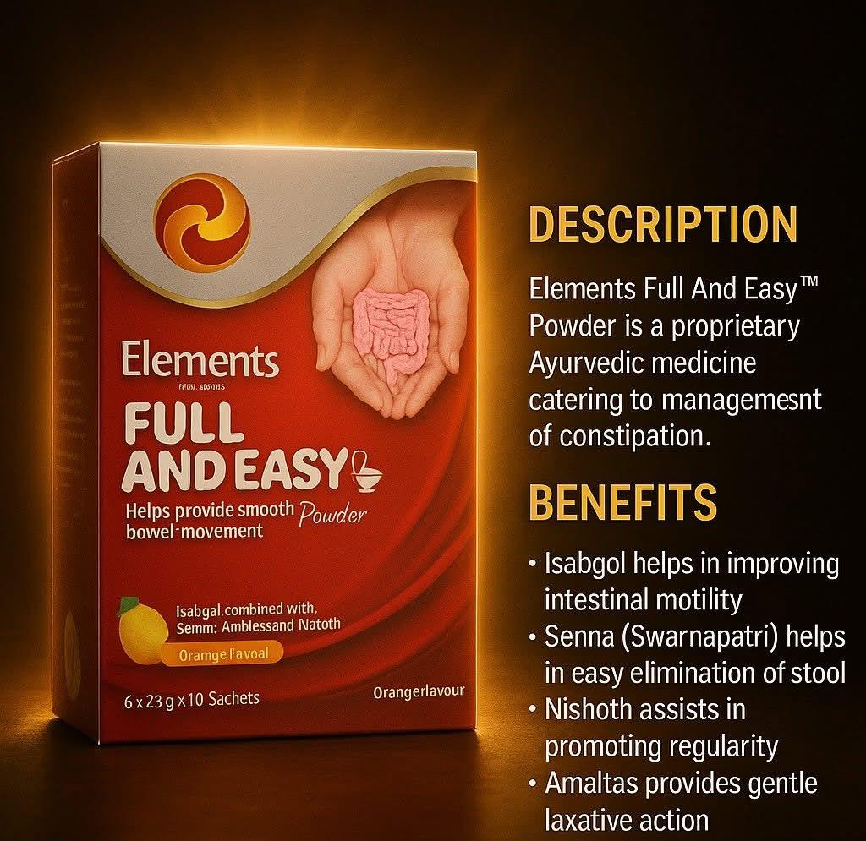

Slide 23
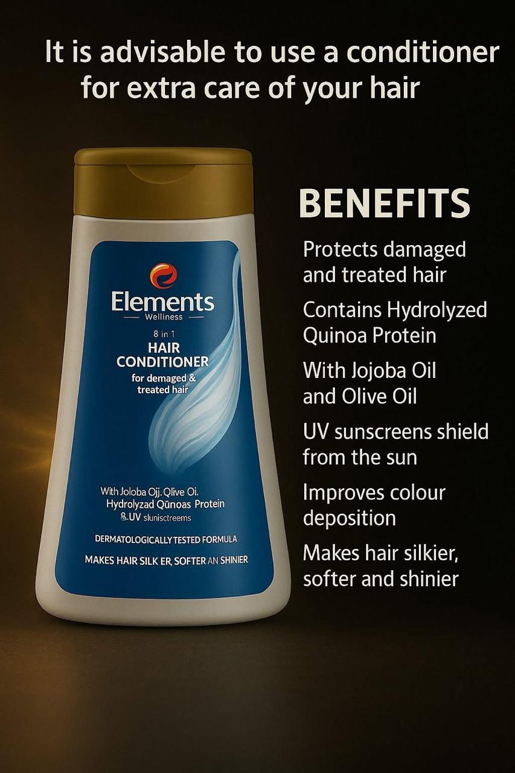
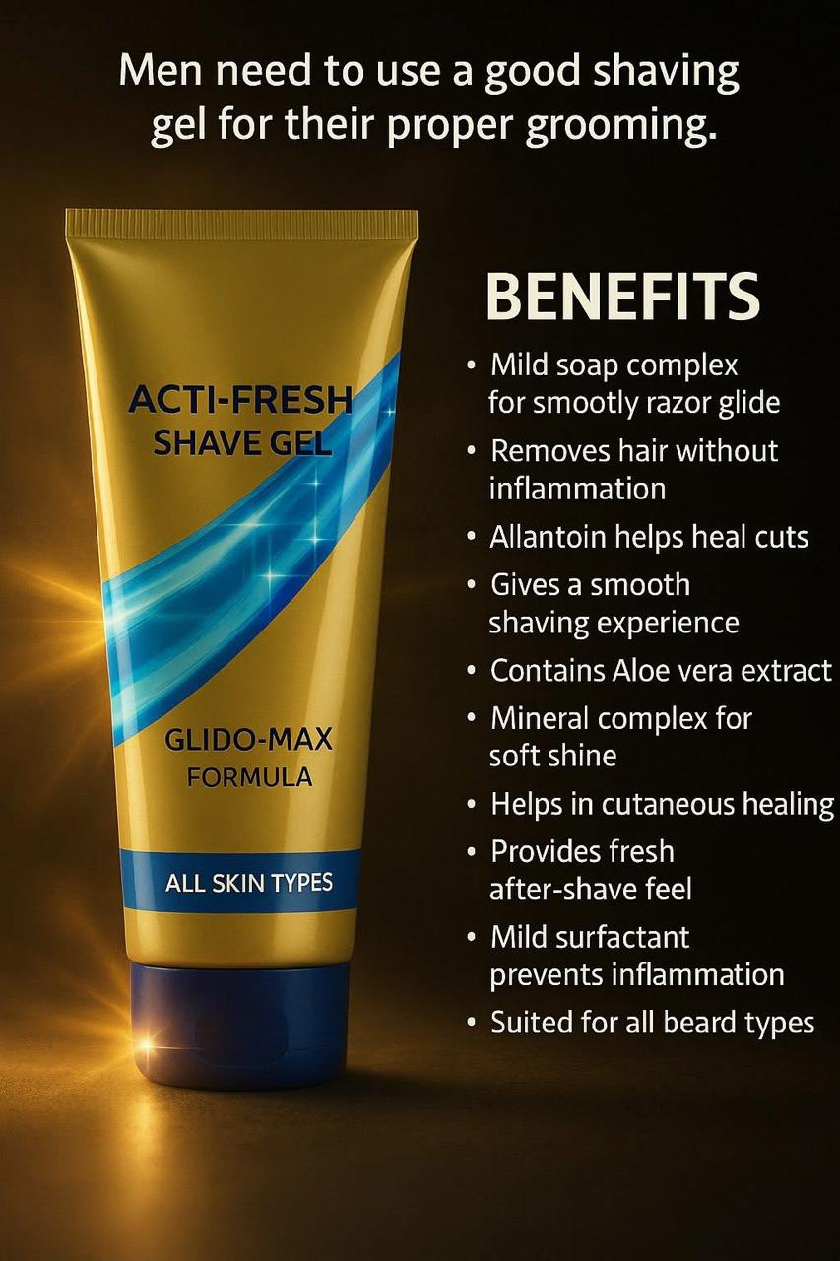

Slide 24
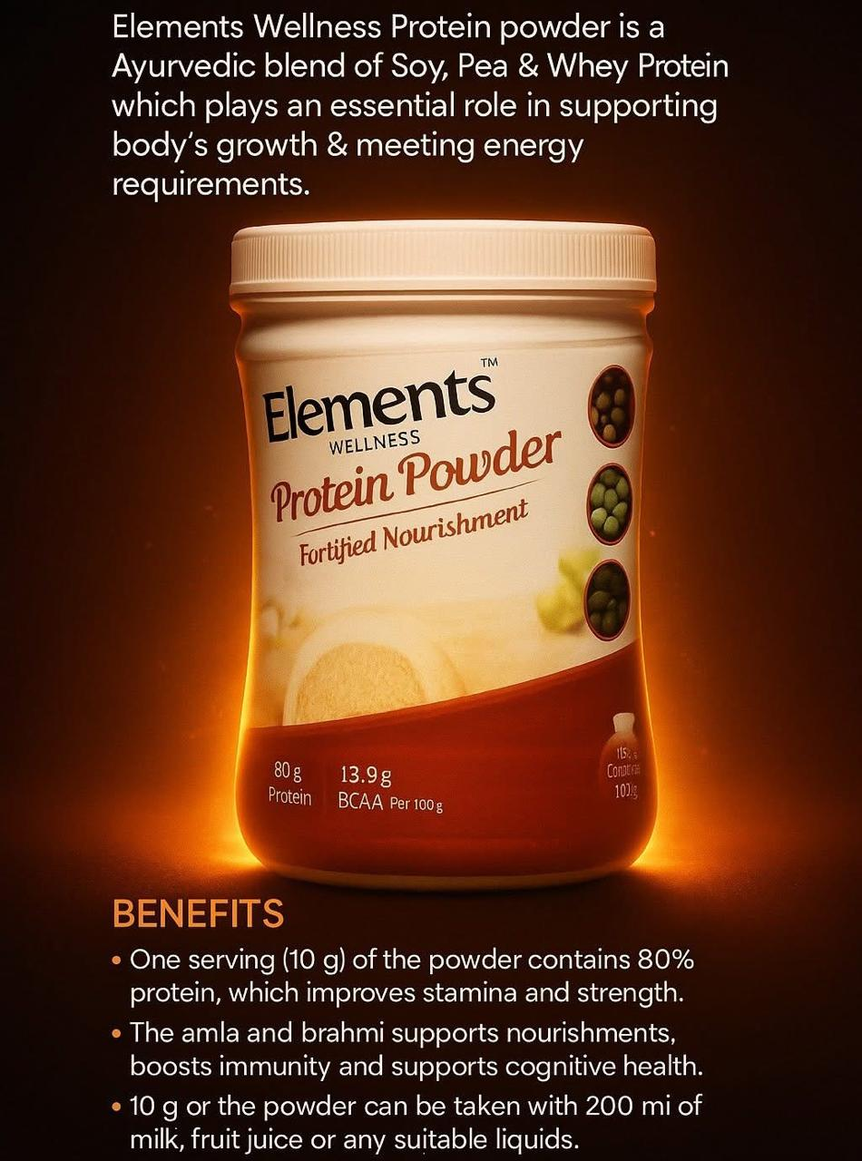


Slide 25



Slide 26

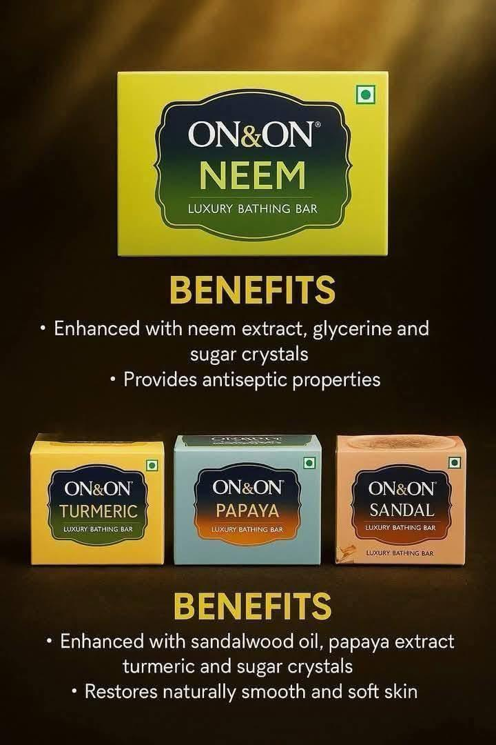

Slide 27
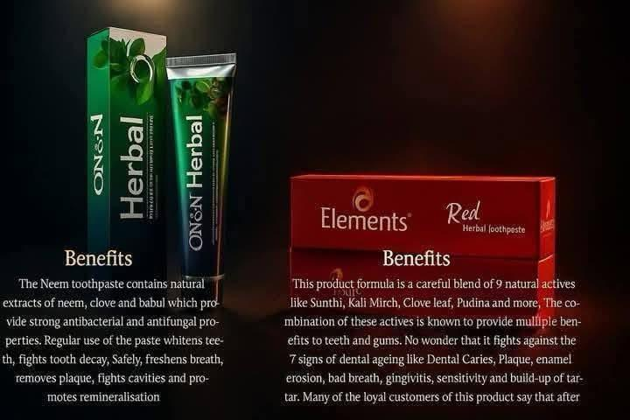

Slide 28
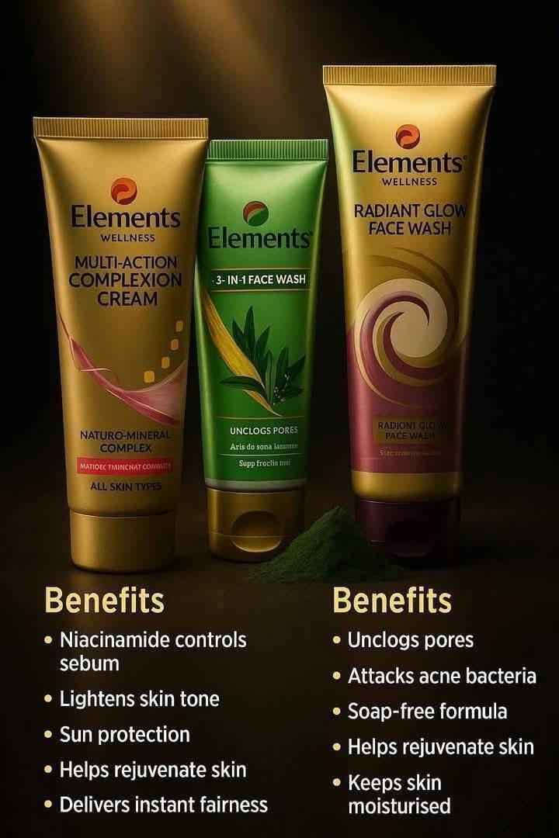
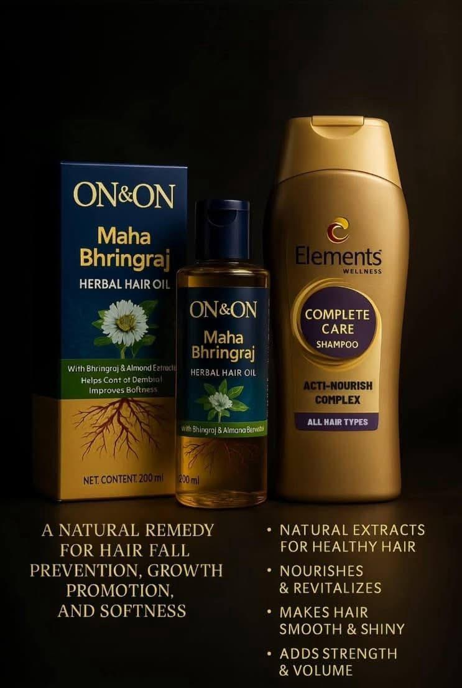

Slide 29

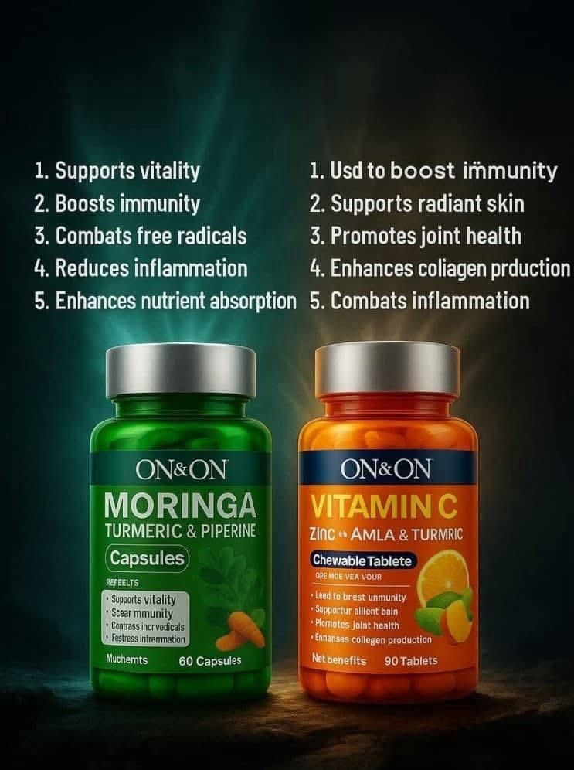

Slide 30



Slide 31
HEALTH CARE
PERSONAL CARE
FOOD AND BEVERAGE
HOME CARE
AGRO CARE

Slide 32


